Slide 1
NBA Player Analytics - Week 3 Deliverables
Team - D&A champs
Aug 15th, 2021

Slide 2
Presentation

Slide 3
Why NBA Topic was selected:
NBA is one of the favorite sporting event in the US. The viewer rating for NBA shows that this event is one of the biggest sports and entertainment in US. The idea is to make this project more enticing and favorable for the audience.
Source Data:
Used Kaggle to download the following datasets related to NBA:
NBA Player Stats from 2016 to 2020
NBA Player Salaries from 2016 to 2020
NBA Player Salary Cap
Insights from the Data:
There is a new club that wants to build a team and they want to sign up contract with different players. They have a budget of 110 million USD. They want to build a well-balanced team choosing players of different tiers. They want to see players of different tiers so that they can sign up with them
2. A relatively new players want to predict Whether his salary is going to increase, decrease or remains similar in next
subsequent seasons based on his performance statistics in NBA.

Slide 4
Data Discovery and Analysis:
NBA Player Stats and Salary Info for 4 years from 2016-2019 were downloaded from Kaggle as 6 files. They were in 4 different formats.
4 Files had NBA player stats information for 4 years. They were in two different formats
2 Files has NBA Salary information for many years and in two different formats
Data files were cleaned and merged into two files
NBA Player Stats info for 4 years
NBA Salary info for 4 years
Data Visualization:
Used Tableau as a visualization tool
As a selector, by selecting the Tier and Position from the dashboard, the selector gains the following insights about the players,
Top players for each of the stats (eg: 3P, ASST, BLK..)
The average score of each player across all the seasons for each of the stat
How players performed in each of the season for the selected stat
Players salary across each seasons
Players total points across each season
The dashboard has various screens to display the afore mentioned features

Slide 5
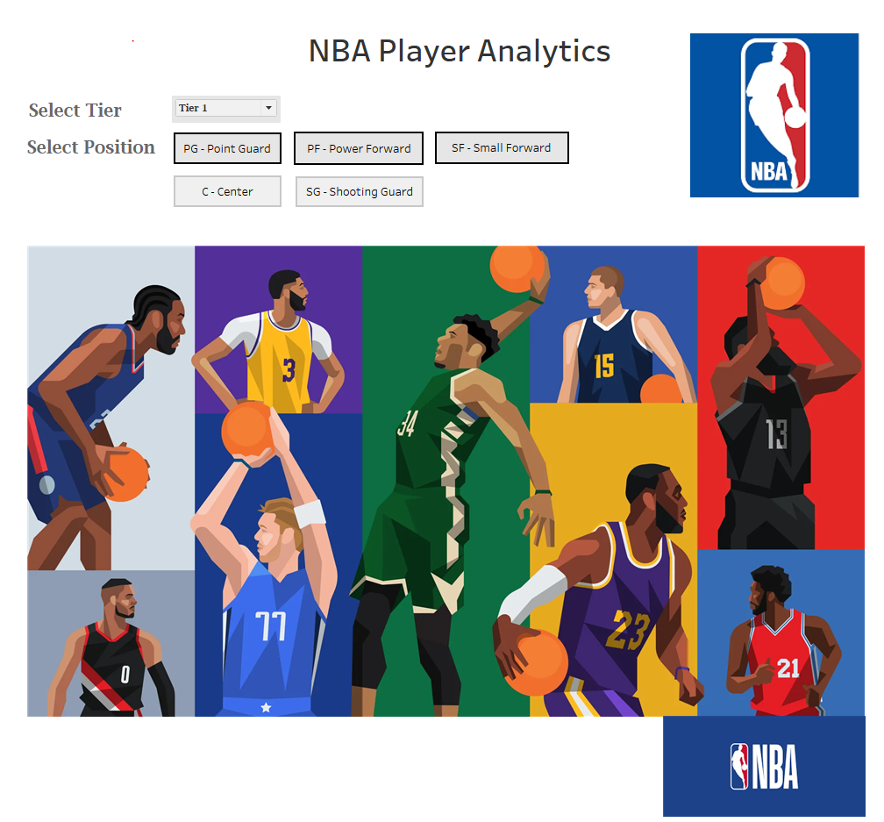
Dashboard Landing Page - Mockup
Selector selects the tier and the position

Slide 6
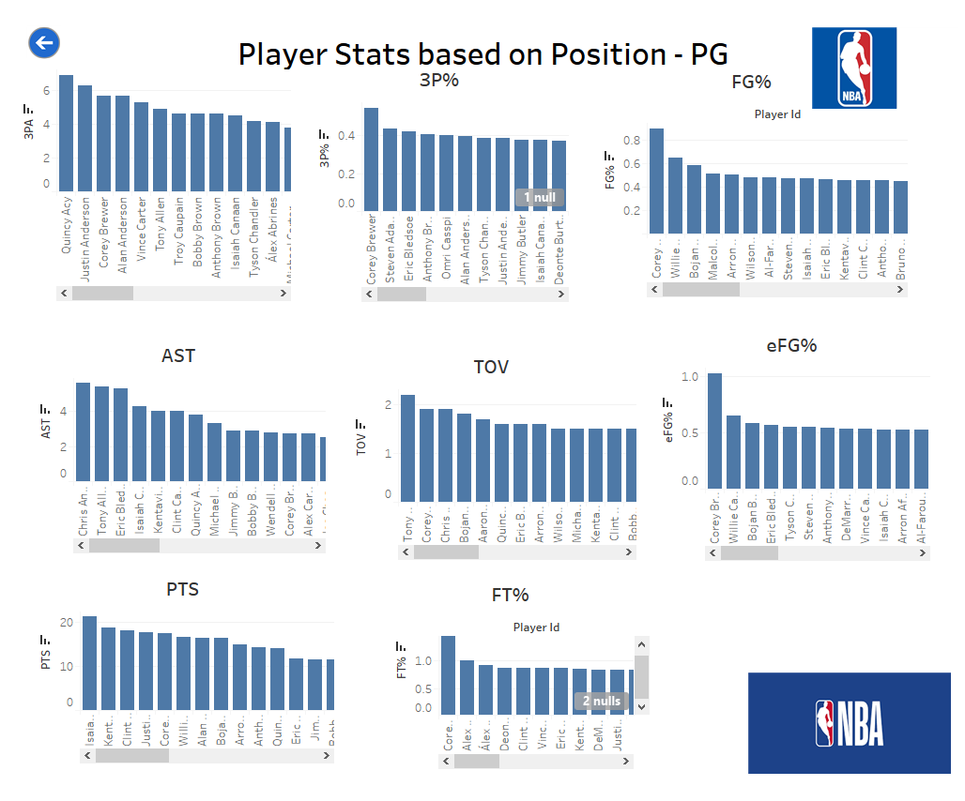
Player Stats Page - Mockup
Back button to go back to previous screen
Each player can be clicked to get further insights about the player, Control navigates to next screen

Slide 7
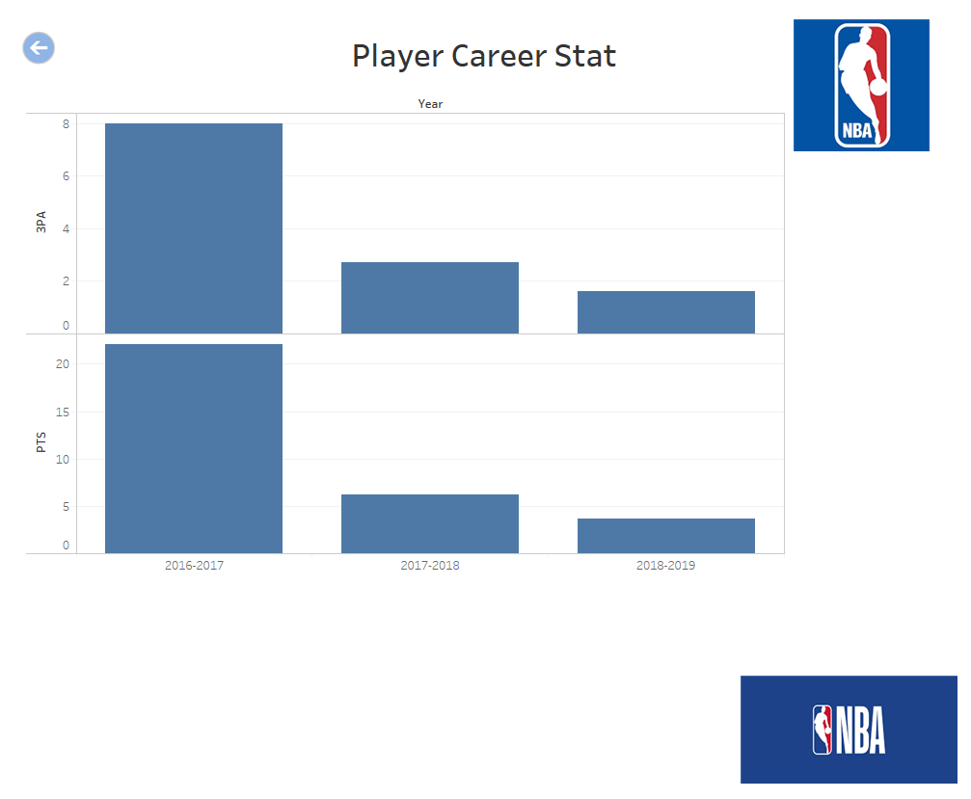
Player Career Stats Page - Mockup
Back button to go back to previous screen

Slide 8
Machine Learning Model

Slide 9
Un-supervised Learning for clustering players based on their available player statistics to find patterns: -
Description of preliminary data processing:–
Both player salary and player statistics data need to be referenced from database (Status – Complete)
Consider players who have played all 4 seasons (2016-17, 2018-19,2019-20,2020-21) for machine learning (Status – Complete)
Join player statistics and player salary and average the stats and salary per player (Status - Complete)
Use all player statistics for clustering them through KMeans Model (Status - Complete)
Derive category of players as player tiers based on the average salary per cluster (Status - Complete)
The code git hub link is as follows:-
http://localhost:8888/notebooks/player-clustering.ipynb
Description of Feature Engineering and Feature Selection:-
Player statistics like ‘np_of_ghames-played’, ‘no_minutes_played’, ‘field_goals_pctg’, ‘three_point_pctg’, ’effective_field_goal_pctg’, ‘free_throws_pctg’, ‘ total_rebounds’ ,’ no_of_assists’ ,’ no_of_steals’, ‘no_of_blocks’, ’ no_of_turnovers’, ‘points’ have been considered as features for clustering since these features reflect
the player’s performance. This data is fed to Kmeans as features.
Why KMeans used, its advantage and limitations:-
KMeans is one of the most popular algoritm for un-supervised learning to find patterns and cluster them.
Benefits of Kmeans – Simple to implement and scales to large datasets
Limitations of Kmeans - Choosing K Manually to find optimal K. It is always a trial and error method to find the optimal K.

Slide 10
Supervised Learning to predict whether Player’s salary hike will happen or not:
Description of preliminary data processing:–
Both player salary and player statistics data need to be referenced from database (Status – Complete)
Consider players who have played all 4 seasons (2016-17, 2018-19,2019-20,2020-21) for machine learning (Status – Complete)
Join player statistics and player salary and average the stats and salary per player (Status - Complete)
Label the ‘Salary Increased or not’ by comparing the last year Vs First year salary (after Standardization) of the players (Status – Complete)
Train and Test the model through Random forest and also in logistic regression. (Status – Complete)
The code git hub link is as follows:-
http://localhost:8888/notebooks/player-salaryraise-predictions.ipynb
Description of Feature Engineering and Feature Selection:-
A round of feature dependencies has been studied using ‘feature_importances_’. The features that had the least dependencies on predictions have been dropped from feature selections.
Refer to the URL to see how the feature dependencies in order to predict the model.
https://github.com/asitkumar26/nba-player-analytics/blob/main/ML-Models/Feature-Depnedencies-Supervised_learning.PNG

Slide 11
Supervised Learning to predict whether Player’s salary hike will happen or not:
Models used for Supervised Learning, its advantage and limitations:-
Randomforest is one of the most popular algoritm for supervised learning to do more accurate predictions.
Benefits of Random Forest – Simple to implement and since it builds multiple decision trees and merges them together to get more accurate and stable decisions.
Limitations of Random Forest - Need to be carefully observed because it has a chance of overfitting the model.
Explanation of Model Choices:
Two models were tried out ‘Random Forest’ and ‘Logistic Regression’. But Random Forest provided better score. Hence
chosen the ‘Random Forest’ for final model.
Description how they have been trained in the model:
Few of the techniques used to train to improve the model accuracy. They are:
- Features like ‘Games Played’ and ‘Minutes Played’ have been scaled through MinMaxScalar.
- Some of the features like ‘salary’ and ‘blocks’ have been dropped because their depnednecies on predictions were least.
Description of Current Accuracy Score:
Find the accuracy score and the Confusion Metrics from ‘Random Forest’ through following URL.
https://github.com/asitkumar26/nba-player-analytics/blob/main/ML-Models/Model-Accuracy-Score-SupervisedLearning.PNG

Slide 12
Dashboard

Slide 13
Dashboard:
Used Tableau as a visualization tool
As a selector, by selecting the Tier and Position from the dashboard, the selector gains the following insights about the players,
Top players for each of the stats (eg: 3P, ASST, BLK..)
The average score of each player across all the seasons for each of the stat
How players performed in each of the season for the selected stat
Players salary across each seasons
Players total points across each season
The dashboard has various screens to display the afore mentioned features

Slide 14
Dashboard Landing Page - Mockup
Selector selects the tier and the position

Slide 15
Player Stats Page - Mockup
Back button to go back to previous screen
Each player can be clicked to get further insights about the player, Control navigates to next screen

Slide 16
Player Career Stats Page - Mockup
Back button to go back to previous screen

Slide 17
Database

Slide 18
Data Discovery and Analysis:
NBA Player Stats and Salary Info for 4 years from 2016-2019 were downloaded from Kaggle as 6 files. They were in 4 different formats.
4 Files had NBA player stats information for 4 years. They were in two different formats
2 Files has NBA Salary information for many years and in two different formats
Data files were cleaned and merged into two files
NBA Player Stats info for 4 years
NBA Salary info for 4 years
Data Cleanup Tasks:
Split player column into two columns: player_id and player_name
Multiple rows exist for a player who is traded mid-season.
Filter and keep the relevant row that has the total for the season
Add Salary from both teams and save it
Convert Salary column to float after removing ‘$’ and space
Add playing season as additional column
Fill null values with 0 for stats and salary.
Pick the columns that is needed for analysis and rename them to match sql database design

Slide 19
Github

Slide 20
Git Hub:
Four branches were created for merging changes from Teammates
asit-modifications
dave-modifications
dhana-modifications
rajesh-modifications
Readme file was updated with
Project Objective
Resources
Github and Branch Info
Software Used
Project Summary
Database
Dashboard
Machine Learning

